Slide 1

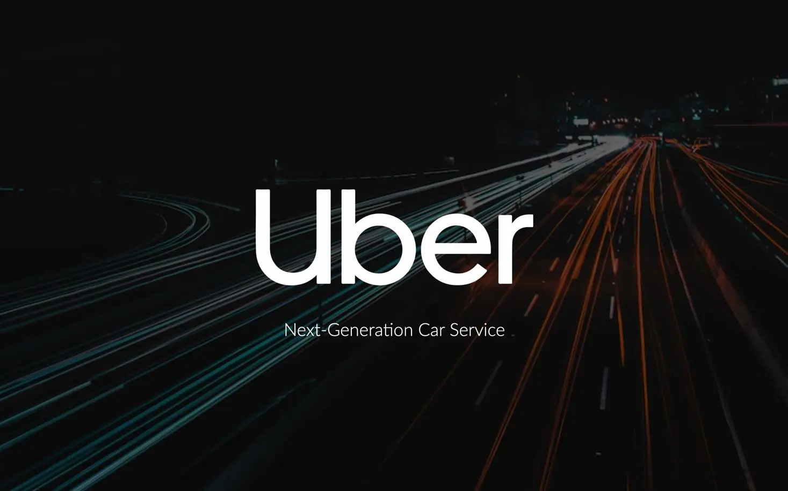


Slide 2
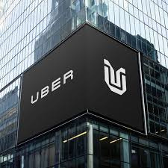

Overview
1. Macro Strategy
1.1. 7 questions and statements about the compagny
1.2. Porter’s force
1.3. Scope (Market situation vs Competitors)
1.5. SWOT
1.6. Opportunities / Risks
1.7. Position of UBER
1.8. UBER income statement
1.9. UBER profit forecast
2. Micro strategy
2.1. Schedule relative to the SWOT analysis
2.2. Risks and opportunities

Slide 3



UBER
Macro strategy
Gerente General

Slide 4


When ? Who ?
What are the main services Uber offers besides ride-hailing?
Uber was founded in March 2009 by Garrett Camp and Travis Kalanick in San Francisco, California. The company officially launched its services in 2010.
Uber Eats (food delivery), Uber Freight (trucking logistics)
Uber for Business (corporate transport solutions)
Uber Reserve (pre-scheduled rides).
Uber Jump (e-bikes and scooters)
How much ?
Why ?
$35 billion in revenue (2023), costs include driver payments, technology, and expansion.
To improve urban mobility, reduce car dependency, and provide earning opportunities.
How has Uber responded the criticism regarding driver pay and working conditions?
How ?
Mobile app, GPS tracking, surge pricing, AI-based route optimization, digital payments.
Uber is criticized for treating drivers as independent contractors, limiting their benefits and job security. In response, it launched Uber Pro, provided some benefits in certain areas, and faced legal disputes over worker status.

Slide 5
Porter’s force
Industry Rivalry
Threat of new entrants
Uber faces stiff global
competition, including from Lyft in
the US and Careem in the Middle
East and Asia. Other rivals like Didi
Chuxing, Grab and Ola are adding to
the competition, which is based on
price, service and reliability.
Its business model is easy to replicate with low entry barriers, attracting new competitors and increasing market competition.
Threat of substitutes
Uber competes not only with similar
services but also
with taxis and public transportation,
which can divert customers away.
Bargaining of buyers
Bargaining of suppliers
Customers have many alternatives
and areprice-sensitive, forcing
Uber to stay competitive to retain its
user base.
Uber relies on independent drivers,
who have high bargaining power and can impact its reputation and costs.

Slide 6
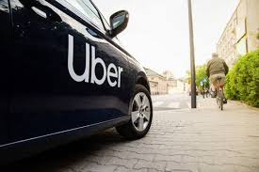

Market situation
Uber is a major player in the global mobility services market, operating in over 70 countries and 10,000 cities. The company has diversified beyond ride-hailing, with Uber Eats (food delivery), Uber Freight (logistics), and micro-mobility (bikes & scooters through Lime).
Market Growth: The sector is expected to reach $150 billion by 2025, driven by urbanization and digitalization, but Uber faces strict regulations and high costs.
Technology & Innovation: Significant investment in AI, route optimization, and autonomous vehicles (via Aurora), with a dynamic pricing model.
Regulatory Environment: Uber must comply with stricter regulations (labor laws, taxation, compliance) in various countries.
Competitor analysis
Uber faces significant competition from various global and regional players in both ride-hailing and delivery services. In ride-hailing, it competes with Lyft in North America, Didi Chuxing in China, and regional players like Bolt and Ola.
In food delivery, rivals include DoorDash in the US, Just Eat Takeaway in Europe, and Meituan in China. Additionally, Uber faces competition in autonomous vehicles from companies like Waymo, Tesla, and Cruise, and maintains partnerships in micro-mobility (e-scooters and bikes) with Lime.

Slide 7

SWOT
Strenths
Huge brand name
Extensive global presence
Technological innovation
Affordable prices
Weaknesses
Threats
Legal challenges and scandals
Overdependance of drivers
Lack of profitability
Competitors
Inapproriate actions by drivers
Low margins
Opportunities
Compagny expansion
Partnerships with other businesses
Diversified offerings

Slide 8
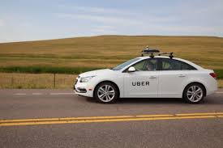
Opportunities
Integration with Fintechs to improve transactions
Expansion in logistics to increase revenue
Development of autonomous mobility services
Expansion in emerging markets
Transition to electric vehicles and sustainable mobility
Risks
Regulatory constraints and unfavorable legislation
Economic slowdown and decline in purchasing power
Intense competition from other mobility platforms
Dependence on drivers and growing dissatisfaction
Cybersecurity and data protection

Slide 9
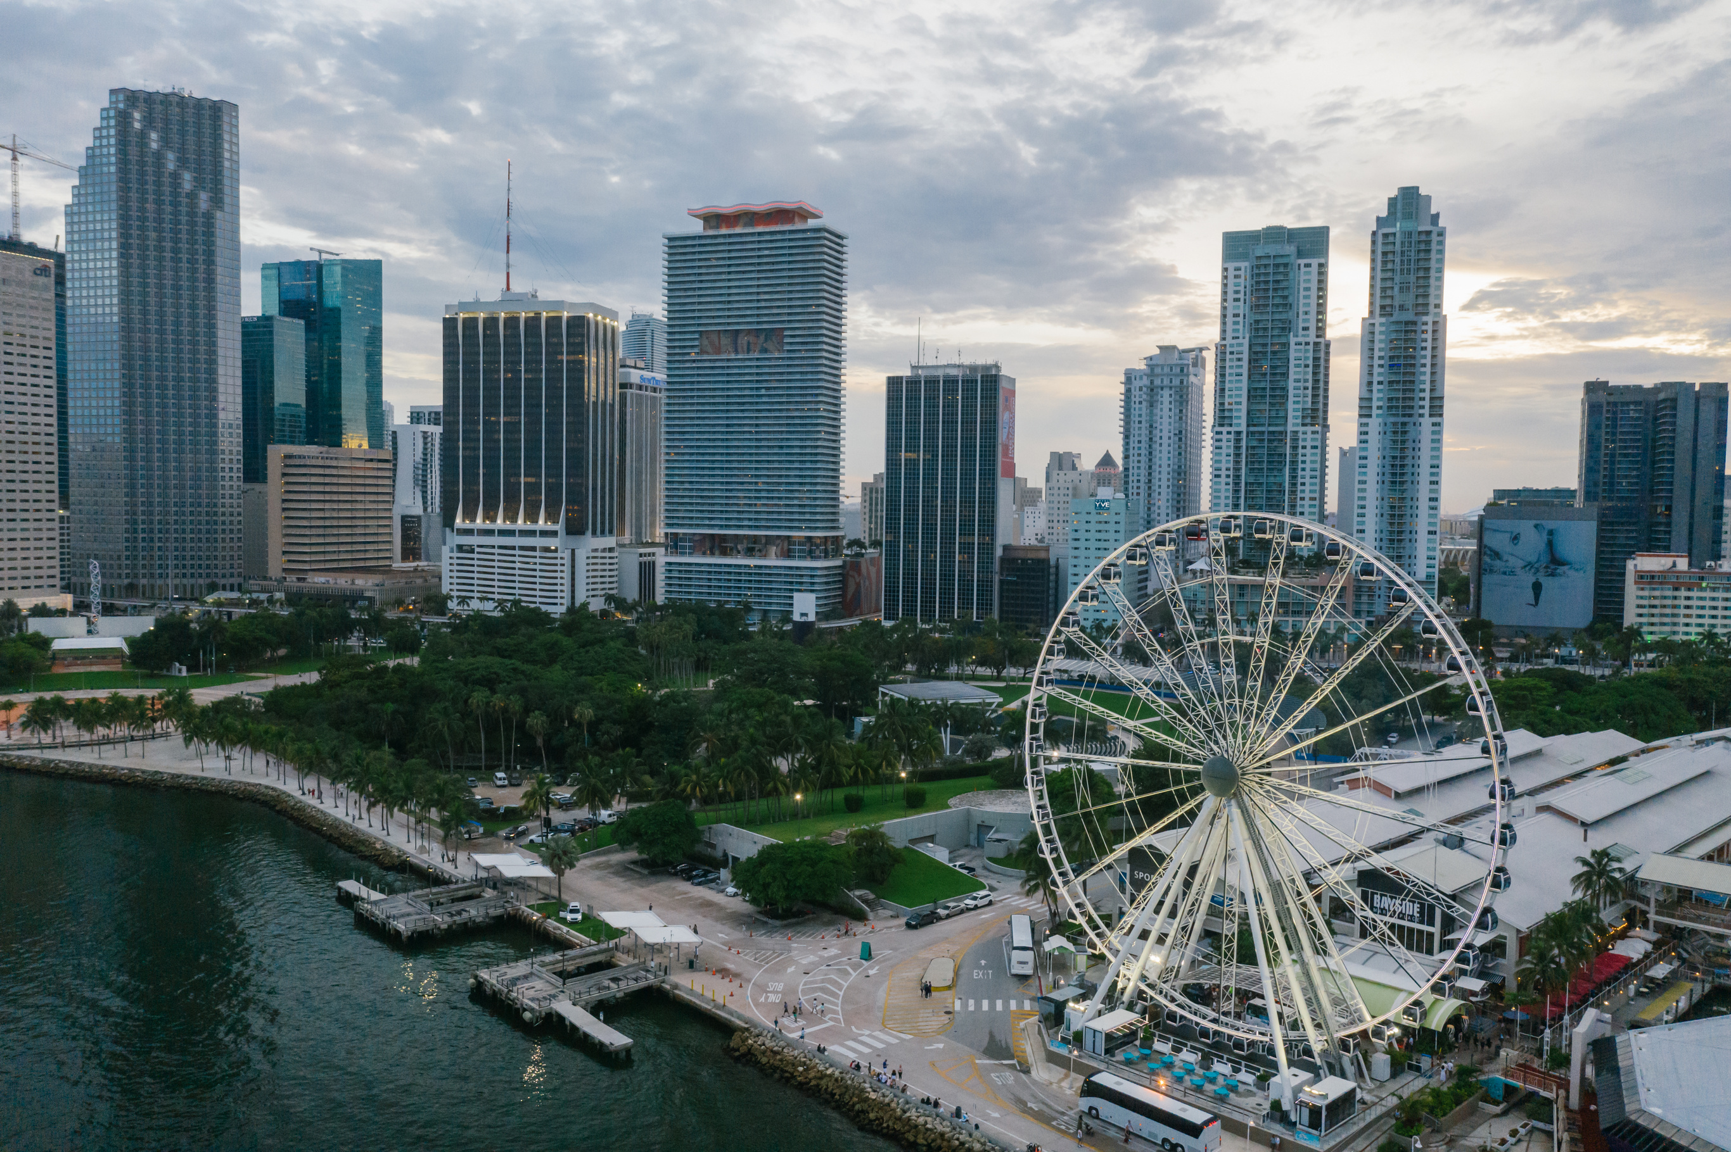

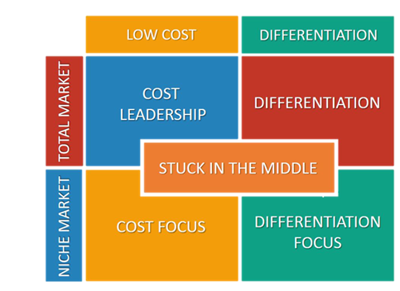

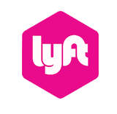





Position of Uber
Position of Uber

Slide 10
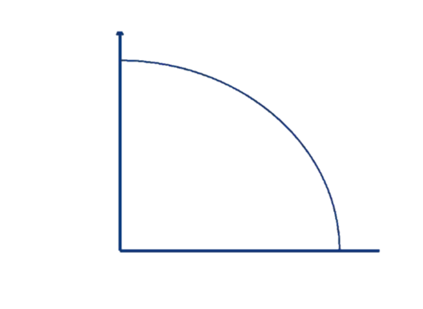

Position of Uber
Position of Uber
high
WTP
low
high
low

Slide 11

UBER Income Statement
Category | 2024 (Actual) | 2029 (Pessimistic) | 2029 (Moderate) | 2029 (Optimistic)
Revenue by Segment (in billion $)
Mobility (Rides) | 38.5 | 45.0 | 55.0 | 70.0
Delivery (Uber Eats) | 15.0 | 18.0 | 22.0 | 30.0
Freight (Uber Freight) | 6.5 | 7.0 | 10.0 | 15.0
Other Revenue | 2.0 | 3.0 | 4.5 | 7.0
Total Revenue | 62.0 | 73.0 | 91.5 | 122.0
Expenses | (60.5) | (70.0) | (84.5) | (107.0)
Profit (Net Income) | 1.5 | 3.0 | 7.0 | 15.0

Slide 12

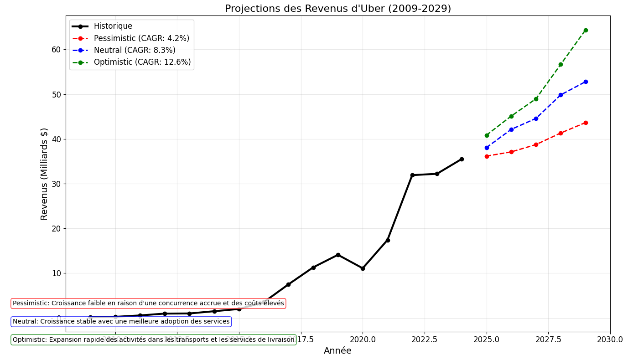
UBER Profit Forecast

Slide 13
UBER
Micro
strategy
Gerente General

Slide 14
Schedule for opportunity development: partnership with other businesses
 | now | 2025 | 2030 | 2035 | 2040 | 2045 | 2050
Identify potential partners
Pilot partnership projects
Negotiate and establish contracts
Integrate services and optimize collaborations
Scale partnerships globally

Slide 15

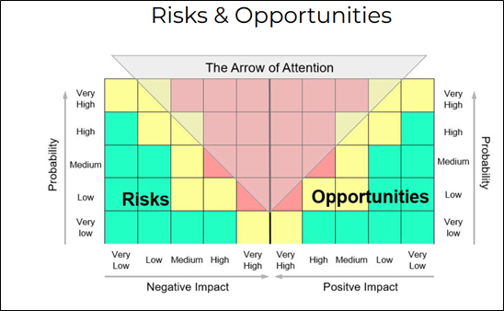
Opportunity : partnerships with other businesses
Regulatory challenges affecting partnerships
Economic downturn reducing business collaborations
Integration with fintech improving transactions
Expansion into logistics increasing revenue
Competition from other mobility platforms
3
1
5
4
2

Slide 16
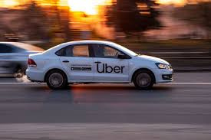

Thank You

